Slide 1
Leading Innovation, Change
(& Effective Teams)

Slide 2
workshop timetable:
  introduction 30 mins
  simulation 120 mins
  debrief 45-60 mins
Notes:
The timings of the simulation workshop are flexible, but this shows a typical 1/2 day workshop timetable, which partly relies on the participants having read the project notes document

Slide 3


Agenda
    Teams leading change
    Introduction to simulation
    Simulation
    Lessons learned

Slide 4
In a Dynamic World:
Power Structures
are fluid, undefined and flattened.
Work Structures
are characterized by shifting interdependencies.
Knowledge Structures
(what we need to know about technologies, markets and competitors) are distributed and changing fast.

Slide 5




The Traditional Model
INTERNAL focus, on teams’:
… goals
… roles
… processes
… interpersonal relationships

Slide 6






The ‘X-Team’ Model
SCOUTING

Slide 7
Changing Minds
Adoption 100%
People seldom change their minds all at once
For important issues, the process is gradual
By own analysis, but also analysis of others
Predictable stages
Speed stakeholders move through stages varies by individual, content, and context
0%
Awareness

Slide 8
Your Challenge
1

Slide 9
Agenda
    Teams leading change
    Introduction to simulation
    Simulation
    Lessons learned

Slide 10
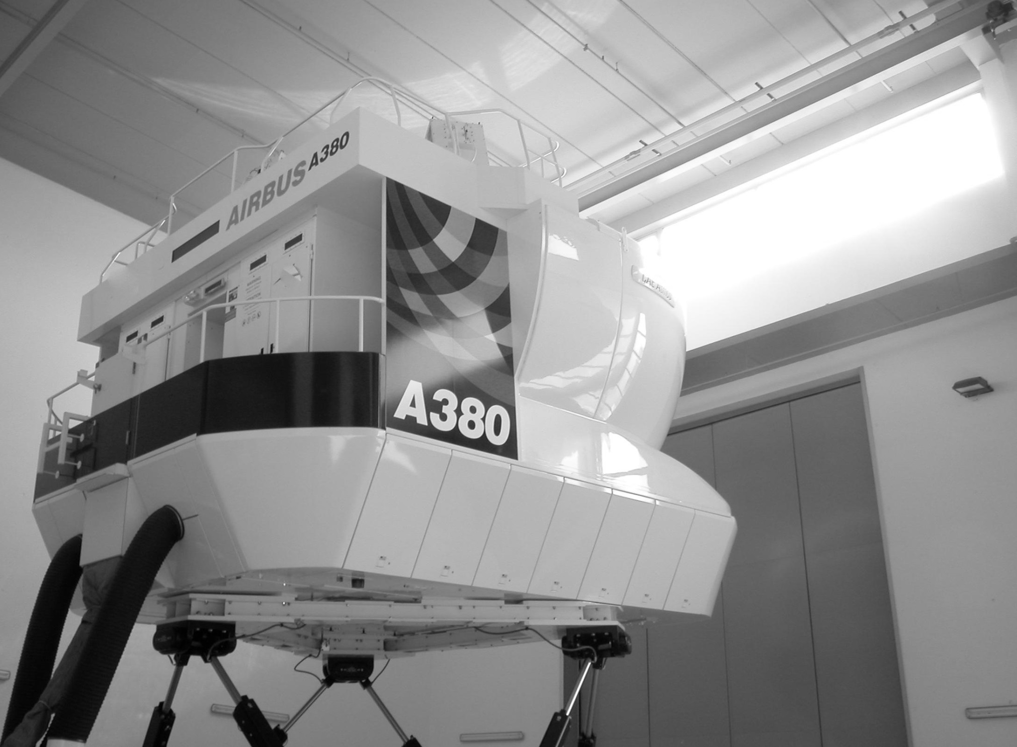
why simulate?
key principle of learning
rapid and transparent
(mostly) fun, no risk
A380 FFS ‘ZFT’, $50million
Notes:
An explanation of why we are using a simulation today: the basic principle is that we learn by doing. The experience will be, in some ways, better than real world experience: it will be quicker and more transparent, i.e. participants will get clear, honest and immediate feedback on how they did. The simulation experience is designed to be mostly fun, but it is still challenging and at times frustrating, like the real world. But ultimately there is no risk in this simulated environment. The image is of an A380 “full flight simulator” that is so effective that pilots can fly a real A380 (with passengers!) without ever having flown a real A380: ‘ZFT’ = Zero Flight Time!

Slide 11
Your Mission
To persuade your organization to adopt the idea, after a new CEO initiative
But you have no formal authority
You have 100 days
Goal is to get all 21 stakeholders to adopt

